Slide 1
Guest or Tourist information centre

Slide 2
General
Survey name
Guest or Tourist information centre
Author
Richard Žižka
Survey language
en
Survey URL
https://www.survio.com/survey/d/Y9H0W3M7W6S7E4X5T
First response Last response
02/28/2014 08/11/2016
Duration
896 days

Slide 3
Survey visits
292
23
33
236
7.9%
Total visits
Total completed
Total unfinished
Displayed only
Overall completion rate
Visit History (02/28/2014 - 08/11/2016)
Total visits (292)
Total completed (23)

Slide 4
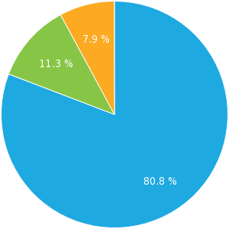
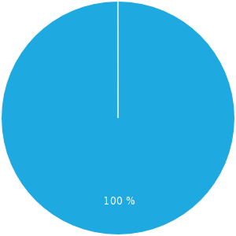
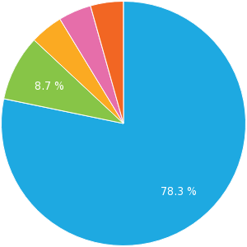
Total Hits
Visit Sources
Average Time of Completion
Displayed only (80.8 %) Unfinished (11.3 %) Completed (7.9 %)
Direct link (100 %)
<1 min. (78.3 %) 1-2 min. (8.7 %) 5-10 min. (4.3 %) 10-30 min. (4.3 %) >60 min. (4.3 %)

Slide 5
How do you use the information centre?
Multiple choice, answers 23x, unanswered 0x
Answer Choices | Responses | Ratio
As a citizen | 14 | 60.87%
As a tourist | 13 | 56.52%

Slide 6
Please indicate your age group below:
Single choice, answers 23x, unanswered 0x
Answer Choices | Responses | Ratio
0-20 | 5 | 21.74%
21-30 | 7 | 30.43%
31-40 | 3 | 13.04%
41-50 | 4 | 17.39%
51-60 | 2 | 8.7%
61+ | 2 | 8.7%

Slide 7
How often do you use the information centre?
Single choice, answers 23x, unanswered 0x
Answer Choices | Responses | Ratio
More than once per month | 6 | 26.09%
Monthly | 10 | 43.48%
Yearly | 4 | 17.39%
Less often | 3 | 13.04%

Slide 8
Why did you visit the information centre? 1/2
Multiple choice, answers 23x, unanswered 0x
Answer Choices | Responses | Ratio
To find information on local travel and the region | 6 | 26.09%
To find information on cultural or social events in the region | 8 | 34.78%
To access the internet | 12 | 52.17%
To use a photocopier | 8 | 34.78%
To find brochures and souvenirs | 8 | 34.78%
To find a city tour with commentary | 5 | 21.74%
To purchase advanced travel or event tickets | 4 | 17.39%
Other (Please specify) | 2 | 8.7%

Slide 9
Why did you visit the information centre? 2/2

Slide 10
How satisfied were you with the following services?
Matrix of single choices, answers 23x, unanswered 0x
 | Very satisfied | Satisfied | Indifferent | Dissatisfied | Very dissatisfied
The services on offer | 6 | 5 | 7 | 2 | 3
The quality of the services provided | 4 | 6 | 9 | 3 | 1
The internet connection speed/avalability | 2 | 9 | 8 | 3 | 1
The access, comfort and hospitality | 5 | 3 | 10 | 5 | 0
The quality of service provided by the staff | 5 | 4 | 7 | 4 | 3

Slide 11
Did the information centre have what you needed?
Single choice, answers 23x, unanswered 0x
Answer Choices | Responses | Ratio
Yes | 15 | 65.22%
No | 8 | 34.78%

Slide 12
Have you ever visited the information centre website?
Single choice, answers 23x, unanswered 0x
Answer Choices | Responses | Ratio
Yes | 15 | 65.22%
No | 8 | 34.78%

Slide 13
Did you find everything you were looking for on our website?
Single choice, answers 23x, unanswered 0x
Answer Choices | Responses | Ratio
Yes | 20 | 86.96%
No (Please let us know what you were looking for) | 3 | 13.04%

Slide 14
Would you say that the information centre was useful or important to your visit?
Single choice, answers 23x, unanswered 0x
Answer Choices | Responses | Ratio
Yes | 19 | 82.61%
No (Please state briefly why this is not the case) | 4 | 17.39%

Slide 15
How would you rate the overall level and quality of the services provided by the information centre? 1/2
Star Rating, answers 23x, unanswered 0x
Answer Choices | Responses | Ratio
10/10 | 3 | 13.04%
9/10 | 2 | 8.7%
8/10 | 3 | 13.04%
7/10 | 3 | 13.04%
6/10 | 3 | 13.04%
5/10 | 2 | 8.7%
4/10 | 2 | 8.7%
3/10 | 1 | 4.35%
2/10 | 2 | 8.7%
1/10 | 2 | 8.7%

Slide 16
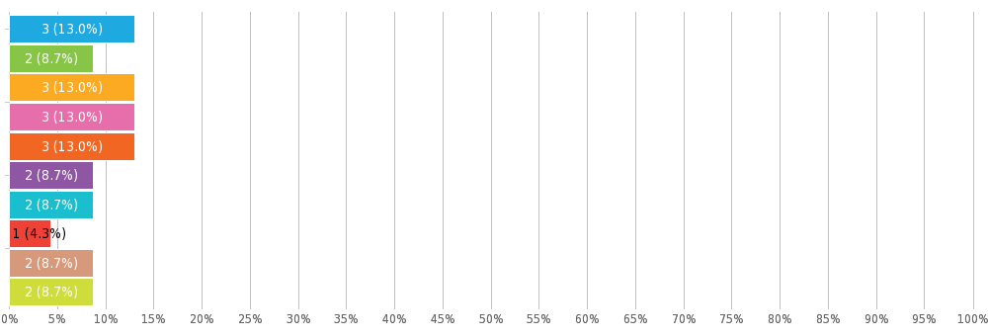
How would you rate the overall level and quality of the services provided by the information centre? 2/2

